Slide 1
PHYS 111 Experiment 3 Newton’s Laws of Linear Motion
Fall 2019

Slide 2
Objectives of Experiment 3
Investigate the meaning of inertia and test Newton’s First Law of motion.
Determine the motion parameters (displacement , velocity, acceleration) of a moving body as a function of time.
Investigate and verify Newton's second law.
Notes:
Objectives

Slide 3
Newton’s Laws of Linear Motion
Foundation of Classical Mechanics.
Describe the relation between an object’s motion and the forces acting on it
Notes:
We can use the second bullet point to initiate a discussion amongst the students: Can an instrument reduce systematic error? If so, in what cases? Can an instrument reduce random error? If so, when and how?

Slide 4
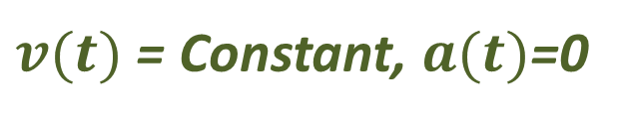

Newton’s Laws of Linear Motion
Newton's First Law of motion states that an object tends to stay in its state of motion as long as there is no net force acting on it.
This tendency of the object to stay in its state of motion is called the Inertia of the object.
$$Fnet=0$$
$v(t)$ = Constant, $a(t)$=0

Slide 5
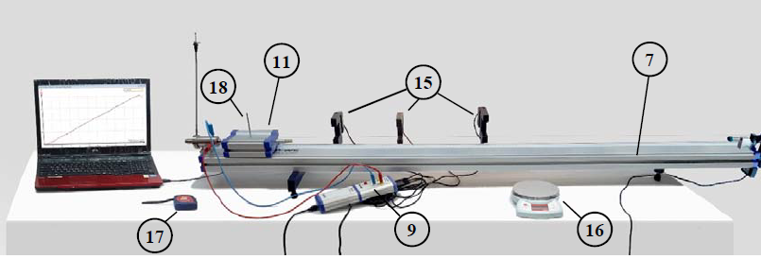
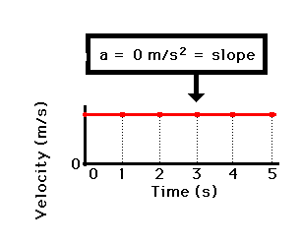
Newton's First Law Experiment Setup

Slide 6


Newton’s Laws of Linear Motion
Newton's Second Law of motion states that as long as a net force acts on an object, its velocity accelerates in the direction of the net force
$$Fnet = Ma$$
M
$$a(t)=\frac{d v(t)}{dt}$$

Slide 7
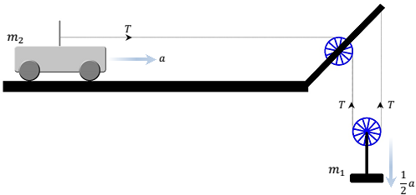
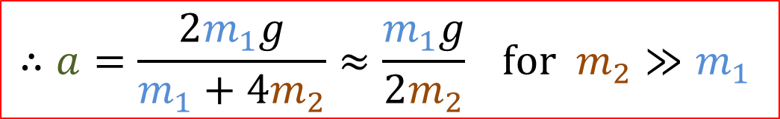
Newton’s second Law of Linear Motion
Example:
$$∴a=\frac{2m_{1}g}{m_{1}+4m_{2}}≈\frac{m_{1}g}{2m_{2}} for m_{2}≫m_{1}$$

Slide 8
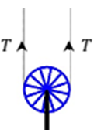
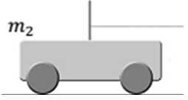


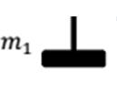



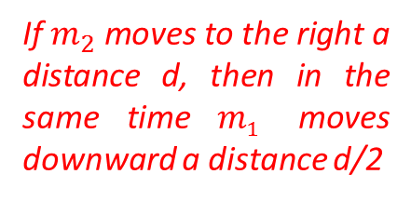










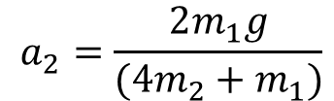
Free-body Diagrams
$$a_{2}$$
If $m_{2}$ moves to the right a distance d, then in the same time $m_{1}$ moves downward a distance d/2
$$m_{1}g−2T_{1}=m_{1}\left(\frac{a_{2}}{2}\right)$$
$$a_{1}$$
$$m_{1}g−2(m_{2}a_{2})=m_{1}\left(\frac{a_{2}}{2}\right)$$
Our pulley has negligible mass
$${2m}_{1}g−4(m_{2}a_{2})=m_{1}a_{2}$$
$$m_{1}g−{2T}_{1}=m_{1}a_{1}$$
$$a_{2}\left(4m_{2}+m_{1}\right)={2m}_{1}g$$
$$m_{1}g−{2T}_{1}=m_{1}a_{1}$$
$$T_{1}=m_{2}a_{2}$$
$$T_{1}=m_{2}a_{2}$$
$$a_{2}=\frac{2m_{1}g}{(4m_{2}+m_{1})}$$

Slide 9
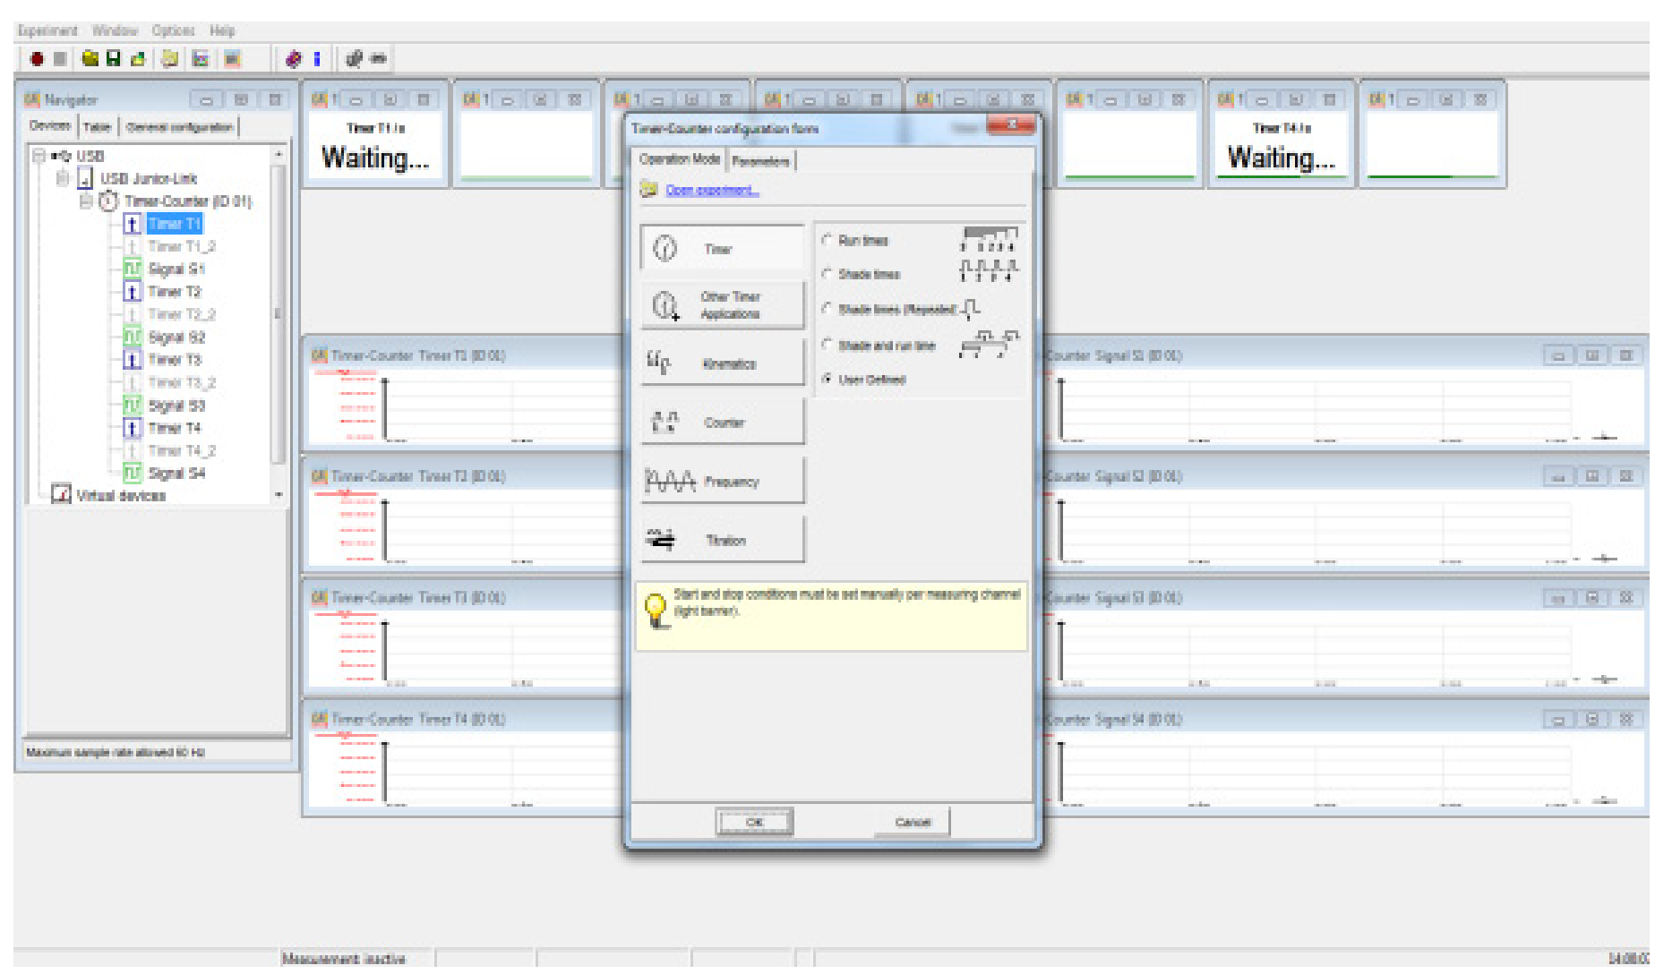


Newton’s Laws of Linear Motion
In this experiment, you will use Cobra 4 sensors, interface, and “Measure” software to collect the data.

Slide 10
Useful links:
Newton’s Laws of Linear Motion
https://www.youtube.com/watch?v=iH48Lc7wq0U
Constant acceleration motion
http://www.physics.umd.edu/courses/Phys111/goodman/java/phe/n2law.htm

Slide 11
Objectives of Experiment 3
Investigate the meaning of inertia and test Newton’s First Law of motion.
Determine the motion parameters (d, v, a) of a moving body as a function of time.
Investigate and verify Newton's second law.
Notes:
Objectives

